Slide 1

SECURITY EVALUATION OF PATTERN CLASSIFIERS UNDER ATTACK
Name: Parvathi Saxena
Course: M.Tech Advanced Computing & Data Science

Slide 2
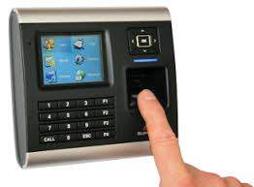

INTRODUCTION
Commonly used in adversarial applications
Purposely manipulated by humans
Based on machine learning algorithms
E.g.
Biometric authentication
Network intrusion detection
Spam filtering

Slide 3

ADVERSARIAL SCENARIOS
Biometric Authentication System:
Spoofing Attack
Network Intrusion Detection Systems:
Evade IDS traffic
Spam Filters:
Avoiding Detection
Malicious Webmaster:
Manipulating rankings

Slide 4


HOW SPAM FILTERS WORK?
Spam Filters
Spam-like words
Penalize your email
ISP
ISP

Slide 5
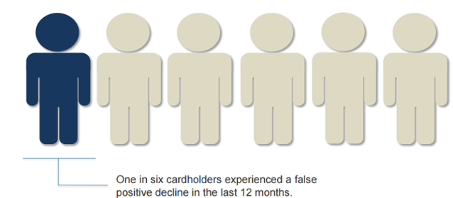
MOTIVATION AND OBJECTIVE
Its relative accuracy and ease of deployment
“Whether the data x is legit or malicious?”
Reduce rate of false positive

Slide 6
Taxonomy
Influence
Security Violation
Specificity
Causative
Exploratory
Integrity
Availability
Privacy

Slide 7
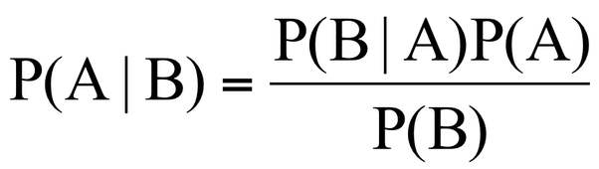
PROPOSED SYSTEM
A model of the adversary
A data model
Recursive Bayesian Filter
A method for generating training and testing sets

Slide 8
ALGORITHM: Construction of TR & TS
Input:
The number n of desired samples: the distributions 𝑝(𝑌) and p(A|Y)
For each y ∈{𝐿,𝑀}, 𝑎∈{𝑇,𝐹}, the distribution
𝑝(𝑋|𝑌 =𝑦, 𝐴 =𝑎), if analytically defined or the set of samples
“ D^{y,a} ”

Slide 9
Output:
A data set 𝑆 (either TR or TS) drawn from 𝑝(𝑌)𝑝(𝐴│𝑌)𝑝(𝑋│𝑌,𝐴)
𝑆 ← ∅
for 𝑖 = 1,…, 𝑛 do
Sample y from 𝑝(𝑌)
Sample a from 𝑝(𝐴|𝑌 = 𝑦)
Draw a sample x from 𝑝(𝑋|𝑌 =𝑦 ,𝐴 = 𝑎), if analytically defined: otherwise, sample with replacement from "D^{y,a}"
𝑆←𝑆∪{ 𝑥 ,𝑦 }
end for
return 𝑆

Slide 10
CONCLUSION
These filters are fairly primitive
Occurrence of false positive not completely eliminated
Model selection is more subjected to attacks
Selected algorithms should be robust to causative and exploratory attacks
Limitation is that security evaluation is carried is data dependent
Model-driven analyses requires a full analytical model of the problem and of the adversary’s behavior

Slide 11
REFERENCES
IEEE transaction, vol 6 april 2016,“Security Evaluation of Pattern Classifiers under Attack” Battista Biggio, Member, IEEE , Giorgio Fumera, Member, IEEE , and Fabio Roli, Fellow, IEEE
D.B. Skillicorn, “Adversarial Knowledge Discovery”, IEEE Intelligent Systems, vol. 24, no. 6, Nov./Dec. 2009.
S. Rizzi, “What-If Analysis”, Encyclopedia of Database Systems,pp. 3525-3529, Springer, 2009.
https://archive.ics.uci.edu/ml/machine-learning-databases/

Slide 12


